Slide 1
Fifa World Cup

Slide 2
Introduction
Objective
Benefits
Problem Statement
By leveraging data from various tournaments, teams, players, and matches, we aim to provide a comprehensive overview of the world’s most prestigious football event. The dashboard will enable users to explore historical results, player performance, team rankings, and other relevant metrics, ultimately enhancing our understanding of the game and its impact on a global scale.
Real-Time Insights: Stay up-to-date with live match scores, player stats, and team standings during the tournament.
Data-Backed Decisions: Coaches and analysts can make informed decisions based on historical performance trends.
Engaging Fan Experience: Fans can explore interactive visualizations, reliving iconic moments and comparing their favorite teams.
Global Football Insights: Gain a deeper understanding of the game’s impact worldwide, from team rivalries to player achievements.
Data Complexity: The vast amount of FIFA World Cup data poses a challenge in extracting meaningful insights.
Historical Trends: Understanding performance trends across tournaments requires effective data visualization.
Decision Support: Coaches and analysts need actionable information for strategic decisions.
Fan Engagement: Creating an engaging experience for football enthusiasts beyond match scores is essential.

Slide 3
Quick Insight
425
Total Qualified Teams
836
Total Match Played
7635
Total Player

Slide 4
Main KPIs
Total Attendance – 37M
Total Goal Scored– 2379
Total Match Played– 836
Total Qualified Teams– 425
Total Players– 7635

Slide 5
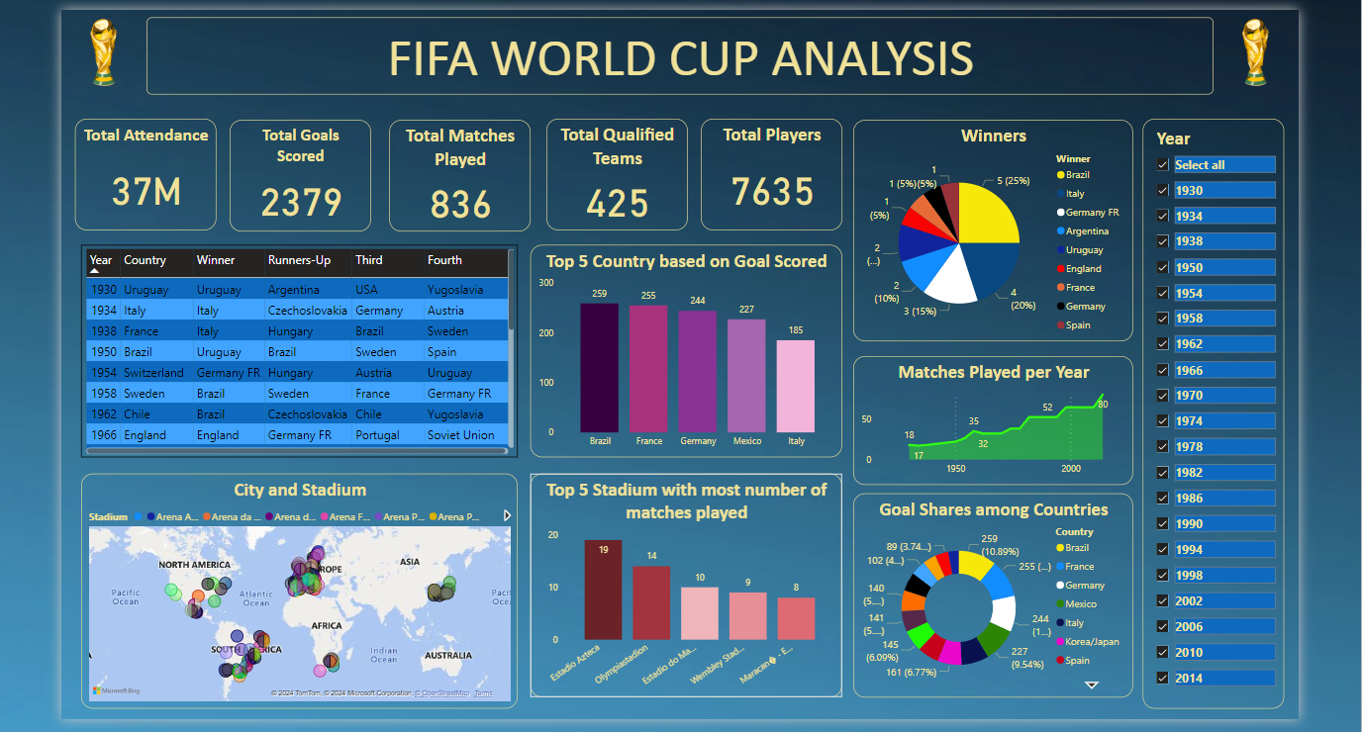
Dashboard

Slide 6
Thank you

